Slide 1
Introdução e Conceitos de Segurança de Software Parte I. Enquadramento e Protecção
Segurança de Software
Julho 2019
Nuno Santos

Slide 2
The problem is Software
“We wouldn’t have to spend so much (…) on network security if we didn’t have such bad software security.
Think about the most recent security vulnerability about which you’ve read.
Maybe it’s a killer packet that allows an attacker to crash some server (…)
Maybe it’s one of the gazillions of buffer overflows that allow an attacker to take control of a computer (…)
Maybe it’s an encryption vulnerability that allows an attacker to read an encrypted message (…)
These are all software issues.”
Viega e McGraw. Building Secure Software. Addison Wesley 2002.

Slide 3


Bad software is everywhere
NASA Mars Climate Orbiter
Crashed due to a units conversion bug ($165 million)
NASA Mars Pathfinder
Stopped for several hours due to a priority-inversion bug ($265 million)
Risks Forum: http://www.risks.org/
http://www.seguranca-informatica.net

Slide 4

Vulnerabilities and more vuln…
US-CERT Technical Cyber Security Alerts
http://www.us-cert.gov/cas/techalerts/
Alert TA15-195A: Adobe Flash & Microsoft Windows Vulnerabilities
Adobe Flash use-after-free and memory corruption vulnerabilities (CVE-2015-5119, CVE-2015-5122, CVE-2015-5123)
Adobe Flash Player contains critical vulnerabilities within the ActionScript 3 ByteArray, opaqueBackground and BitmapData classes. Exploitation of these vulnerabilities could allow a remote attacker to execute arbitrary code on a vulnerable system.
Microsoft Windows Adobe Type Manager privilege escalation vulnerability (CVE-2015-2387)
The Adobe Type Manager module contains a memory corruption vulnerability, which can allow an attacker to obtain system privileges on an affected Windows system. The Adobe Type Manager is a Microsoft Windows component present in every version since NT 4.0. The primary impact of exploiting this vulnerability is local privilege escalation.

Slide 5
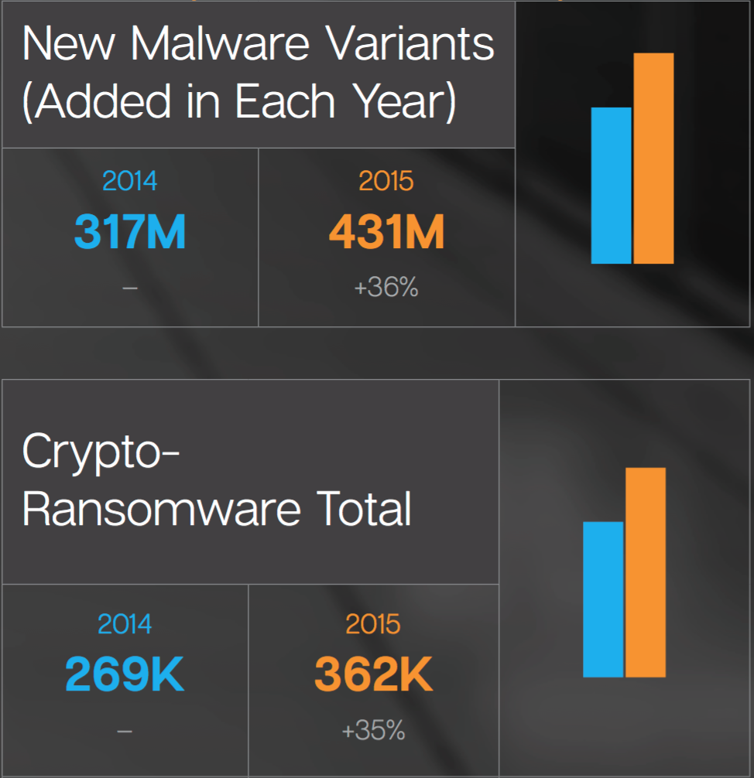
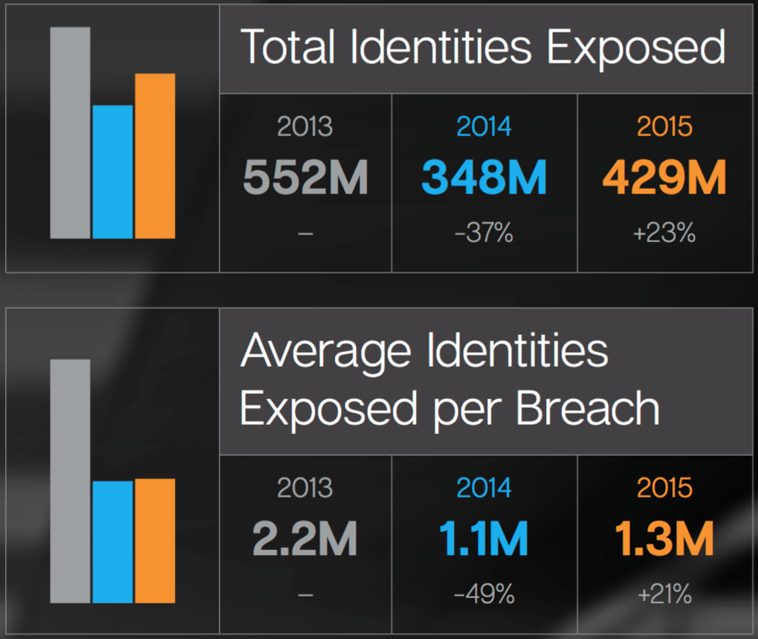
2015 in Numbers
Malware
Identity breaches
Source: Symantec Internet Security Threat Report 2016, Vol. 21, Apr. 2016
Notes:
Ransomware graph: number of attacks

Slide 6
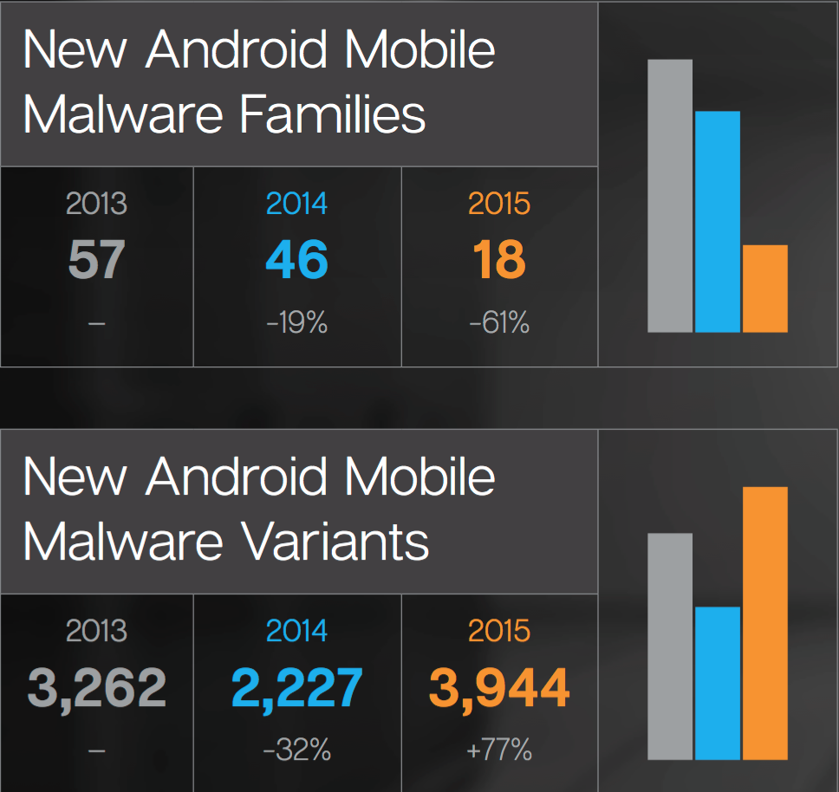
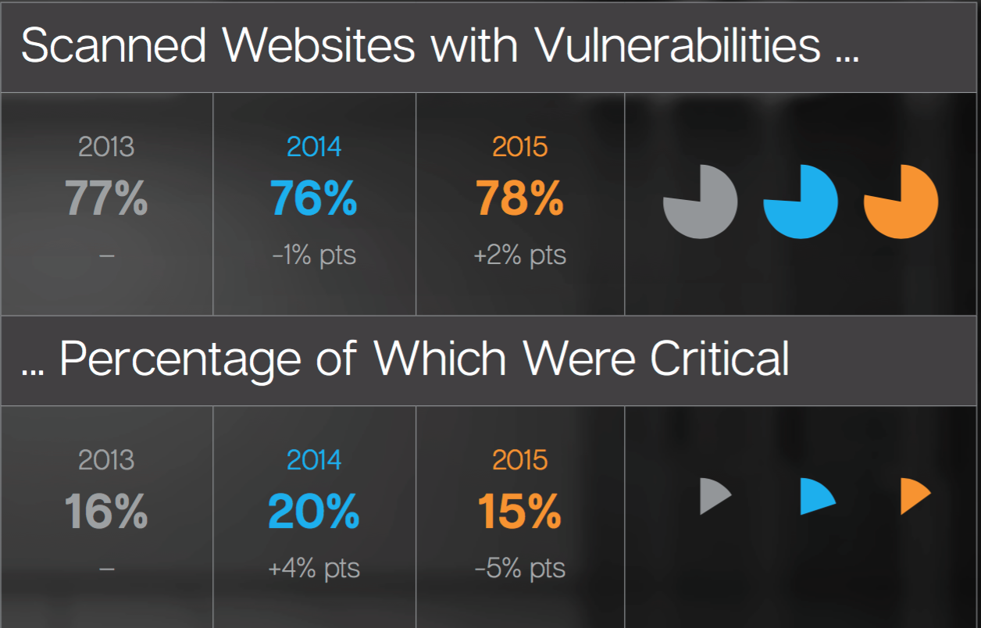
2015 in Numbers
Web
Mobile

Slide 7
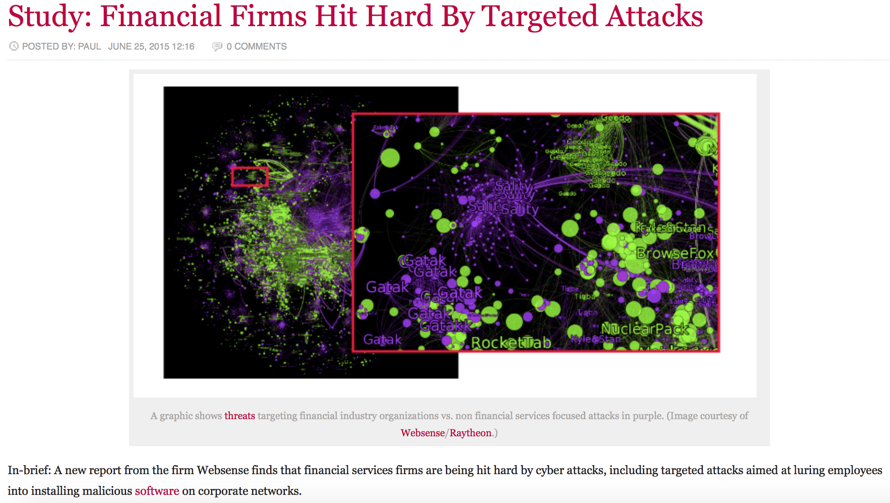

Example: financial firms (2015)

Slide 8
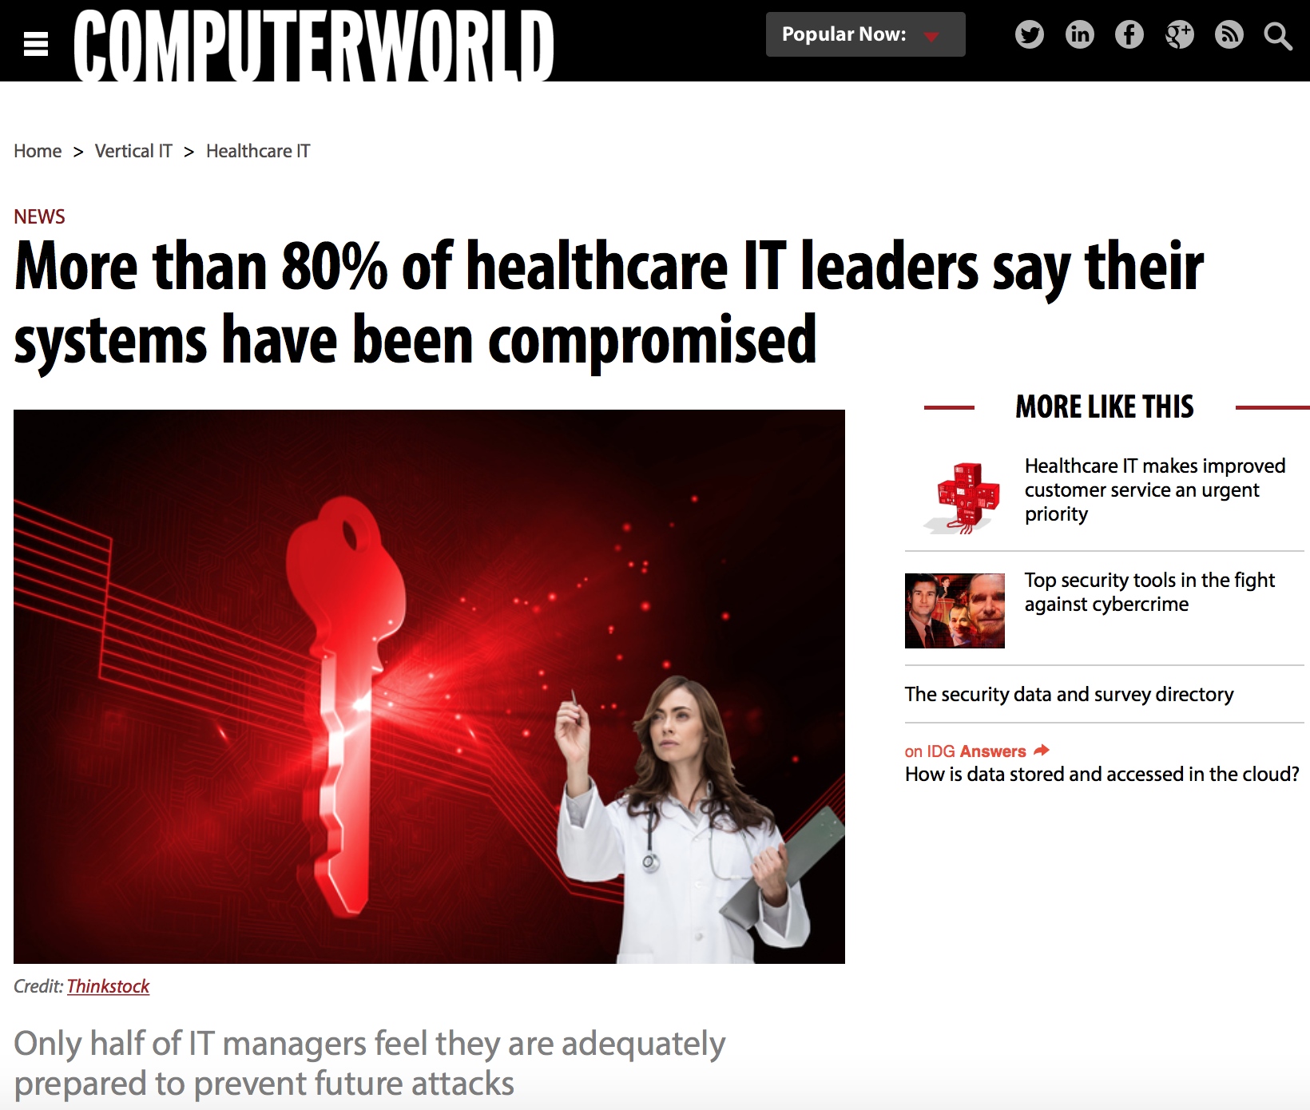
Example: healthcare systems (2015)

Slide 9
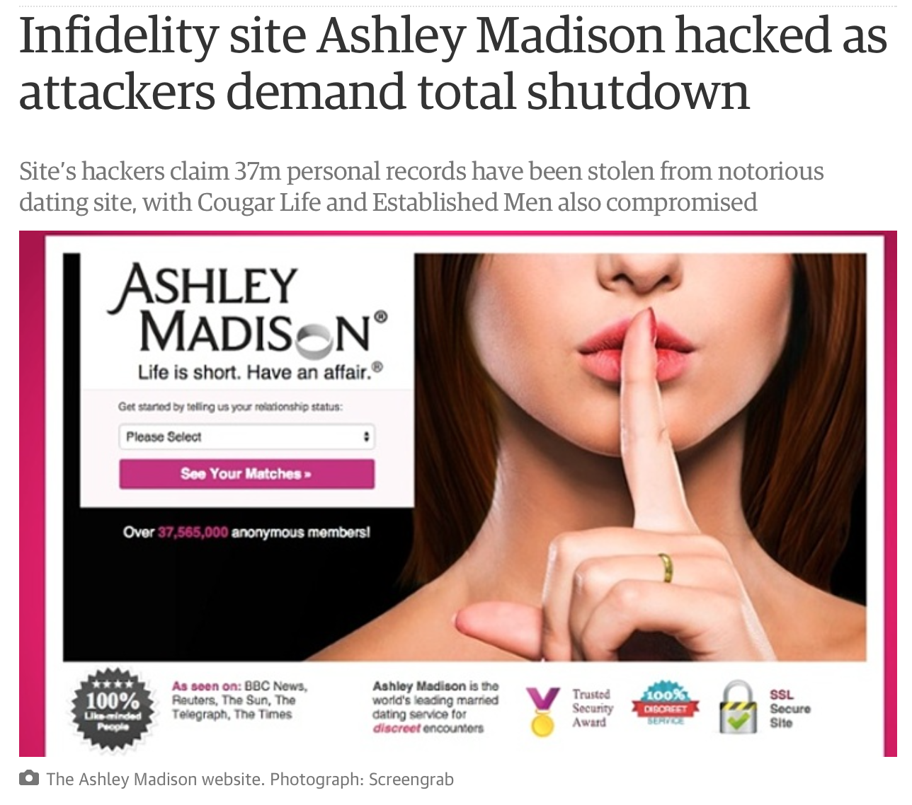

Example: Ashley Madison (2015)
Notes:
mais tarde (Agosto 2015):The Impact Team releases a data dump containing the account details of all 37 million users of Ashley Madison. The files, 9.7 GB total in size, are posted to the dark web using an Onion address and are later revealed to include names, passwords, addresses, phone numbers and credit card transactions of the site’s users.

Slide 10

The problem is Software
“the current state of security in commercial software is rather distasteful,
marked by embarrassing public reports of vulnerabilities and actual attacks,
scrambling among developers to fix and release patches,
and continual exhortations to customers to perform rudimentary checks and maintenance.”
Jim Routh, Forcing Firms to Focus: Is Secure Software in Your Future, in Beautiful Security, O'Reilly, 2010

Slide 11

Industry’s fault?
“Software buyers are literally crash test dummies
for an industry that is remarkably insulated against liability, accountability, and responsibility
for any harm, damages or loss that should occur because of manufacturing defects or weaknesses
that allow cyber attackers to break into and hijack our computer systems.”
David Rice. “Geekonomics: The Real Cost of Insecure Software”, Addison-Wesley, 2007

Slide 12

Universities’ fault?
“We at Oracle have (...) determined that most developers we hire have not been adequately trained in basic secure coding principles (…)
We have therefore had to develop and roll out our own in-house security training program at significant time and expense. (...)
In the future, Oracle plans to give hiring preference to students who have received such training and can demonstrate competence in software security principles.”
Mary Ann Davidson, Oracle’s Chief Security Officer

Slide 13
Trinity of trouble
Complexity
Extensibility
Connectivity

Slide 14
Complexity
Attacks exploit bugs called vulnerabilities
estimated 5-50 bugs per Klines of code (~5 if rigorous quality assurance)
examples:
Solaris7 500K
Windows 95 <5M
Windows XP 45M
Windows Server 2003 50M
Linux kernel 2.6.0 5.2M
Linux kernel 3.6 15.9M

Slide 15
Extensibility
Current SW is inherently extensible:
Device drivers, plug-ins, extensions, modules, Apps,....
Virtual machines and mobile code (JavaScript, Java, .NET, Flash,…)
Combination of several components and forms of code execution (web apps)
Problems:
What is “the software”? How do you ensure its security?
Mobile malicious code: Worms, Virus,…

Slide 16
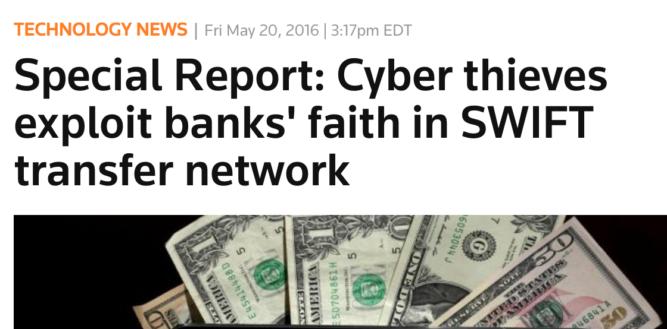
Connectivity
Internet (PCs, smartphones, tablets,…)
Small failures can propagate widely
Allows automated attacks
Major worms 99-04: Melissa, ILOVEYOU, Code Red, Sircam, SQL Hammer, Blaster, Sobig, Mydoom, Sasser, Witty
DDoS attacks (400 Gbps record, Feb. 2014)
Economic risk
SWIFT net connects 10000+ financial institutions and moves zillions of dollars daily; targeted attacks at banks
Distance and feeling of safety

Slide 17
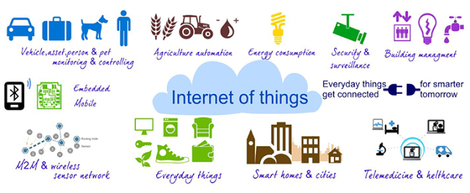
Connectivity: Internet of Things
Not only cable and WiFi but also GSM/3G/4G/5G, Bluetooth, NFC,...
http://www.darkreading.com/risk/cartoon-what-your-toaster-now-needs-/d/d-id/1269204

Slide 18
The 4th trouble: motivation
Attackers have now strong motivations:
Theft – homebanking, credit cards, blackmailing…
http://www.seguranca-informatica.net/2013/07/kins-novo-cavalo-de-troia-ameaca-bancos.html
Spying – between nation states, corporate espionage
http://www.seguranca-informatica.net/2013/08/xkeyscore-um-motor-de-busca-para.html
War – Estonia, Georgia,…
http://www.seguranca-informatica.net/search/label/ciber-guerra
Terrorism
http://www.seguranca-informatica.net/2013/03/ataques-instituicoes-financeiras.html

Slide 19
(Near) future of SW
More components
More frameworks, more combination of binary and executed code
More wireless
More mobile devices and embedded “things”
More distribution
More mobile code
Subscription services
More complexity, extensibility, connectivity

Slide 20
Security: a large industry
“Global Cyber Security spending 2011: $60 billion”
PWC, Cyber Security M&A review, Nov. 2011
“With a cumulative market valued at $65.5 billion (2013 – 2018), the U.S. Federal Cybersecurity market will grow steadily – at about 6.2% CAGR over the next six years.”
U.S. Federal Cybersecurity Market Forecast 2013-2018, April 2013
RSA Conference 2012 S. Francisco
562 speakers, 346 sessions, 350+ companies in the exhibition, several thousand attendees

Slide 21
Objectives of this course
Upon completing this course, students are expected to:
Understand the basics of digital forensics principles & praxis
Acquire hands-on practice on digital forensics investigation
Be prepared for active research at the forefront of this area
Notes:
The knowledge of computer and network forensics has become essential in securing today's network-centric computing environment. This new course will give the students both the fundamental knowledge and hands-on practice on computer and network forensics. The added exposure to forensics will enhance the marketability of our students and serve the students who carry the skills and knowledge forward into their future careers.
Upon completing this course, the students are expected to understand the basics of computer and network forensics, to be well-trained as next-generation computer crime investigators, and to be prepared for active research at the forefront of these areas.
http://home.engineering.iastate.edu/~guan/

Slide 22
Course program
Part I: Foundations of digital forensics
Legal framework, digital investigation, evidence acquisition…
Part II: Basic techniques and tools for digital forensics
Files, steganography, storage, file systems, OSes, packet analysis, email, web…
Part III: Advanced techniques and tools for digital forensics
Rootkits, anonymization, botnets, cryptocurrency, cloud forensics…
Notes:
The knowledge of computer and network forensics has become essential in securing today's network-centric computing environment. This new course will give the students both the fundamental knowledge and hands-on practice on computer and network forensics. The added exposure to forensics will enhance the marketability of our students and serve the students who carry the skills and knowledge forward into their future careers.
Upon completing this course, the students are expected to understand the basics of computer and network forensics, to be well-trained as next-generation computer crime investigators, and to be prepared for active research at the forefront of these areas.
http://home.engineering.iastate.edu/~guan/

Slide 23
What this course is not going to do
Make of you an experienced forensics analyst
That requires lot of fieldwork; here you’ll learn the basics of the praxis
Cover all existing forensic tools and computer technologies
Impossible! We’ll focus on the universal principles underlying them
Analyze in depth the legal aspects involved in digital forensics
This is a computer engineering course, and thus more focused on technology
Describe how existing computer and networked systems work
We assume you have that necessary background from previous courses

Slide 24
Teaching staff
Theoretical and lab classes:
Nuno Santos (theory)
nuno.santos@inesc-id.pt
Tagus: 2N3.1 (office hours: Tuesdays, 14h00)
Alameda: INESC-ID, office 503 (office hours: Thursdays, 9h30)
Diogo Barradas (labs Alameda)
diogo.barradas@tecnico.ulisboa.pt
Alameda: INESC-ID, office 601 (office hours: Thursdays, 14h00)
Filipe Fernandes (labs Tagus)
filipe.r.fernandes@tecnico.ulisboa.pt
Tagus: 2N3.1 (office hours: Tuesdays, 12h30; Fridays, 11h00)
Professor may leave >15min if no students are present
Extra office hours can be arranged by appointment
Notes:
if no students present for 15min.
Extra office hours can be arranged as needed.

Slide 25
Class schedule
Theoretical classes: 2 classes/week, one and a half hour long
Taguspark
Class1: Tuesday, 17h00-18h30, Room A5
Class2: Wednesday, 11h30-13h00, Room A5
Alameda
Class1: Wednesday, 8h00-9h30, Room FA3
Class2: Thursday, 11h00-12h30, Room FA2
Lab classes: 1 class/week, one and a half hour long
Taguspark:
Tuesday, 11h00-12h00, Room 1-27
Tuesday, 15h30-17h00, Room 1-29
Wednesday, 10h00-11h30, Room 1-15
Thursday, 8h00-9h30, Room 1-29
Alameda:
Thursday, 17h00-18h30, TBA
Friday, 8h00-9h30, LAB11

Slide 26
Selection of the lab shift
Each lab shift will function with groups of 3 elements each
Groups are allowed with elements from both campi (Tagus and Alameda)
Enrollment through Fenix, according to the following schedule:
Monday, 24th, 9h:
enrollment opens for complete groups
Wednesday, 26th, 9h:
enrollment opens for groups with two or more elements
Friday, 28th, 9h:
no restrictions
Feel free to choose the lab shift, as long as slots are available
In the end, we will perform group compacting in each shift

Slide 27
Assessment
Lab component (40%) – minimal grade 9
Groups of 3 elements
3 lab assignments and defense
Lab assignments’ submission dates:
Lab 1: 26 October
Lab 2: 23 November
Lab 3: 14 December
Lab grade baseline = 30% Lab1 + 35% Lab2 + 35% Lab3
Lab grade final: defined individually in the defense at the end of the term
Exam (60%) – minimal grade 9
Final exam, January 9th, 11h30
Recovery exam: February 4th, 8h00

Slide 28
Bibliography
Primary: Course slides
Main book: [Casey11]
Digital Evidence and Computer Crime, Third Edition: Forensic Science, Computers and the Internet, 3 edition: Eoghan Casey 2011 - May 4 Academic Press
Secondary bibliography:
Papers and other supplemental material to be provided on the course web site

Slide 29
Plan^{1/2}
week |  | theory |  |  |  | labs
# | dates | days | class # | section | topic | class # | topic | observ.
1 | 17-21 Set | 18,19 Set | 1 | Part I: Foundations of Digital Forensics | Introduction |  | No class
 |  | 19,20 Set | 2 |  | I.1. Legal Framework
2 | 24-28 Set | 25,26 Set | 3 |  | I.2. Digital Investigation Process |  | Lab enrolment
 |  | 26,27 Set | 4 |  | I.3. Evidence Acquisition
3 | 1-5 Out | 2,3 Out | 5 | Part II: Basic Techniques and Tools for Digital Forensics | II.1 File Forensics | 1 | Tutorial I: Introduction to Forensic Tools
 |  | 3,4 Out | 6 |  | II.2. Steganography and Watermarking
4 | 8-12 Out | 9,10 Out | 7 |  | II.3. Storage and Memory Analysis | 2 | Tutorial II: Training for Lab Assignment 1
 |  | 10,11 Out | 8 |  | II.4. File System Analysis Techniques
5 | 15-19 Out | 16,17 Out | 9 |  | II.5. File Carving and Timestamp Analysis | 3 | Lab Assignment 1 | Lab 1 published: 1 October
 |  | 17,18 Out | 10 |  | II.6. Operating System Forensics
6 | 22-26 Out | 23,24 Out | 11 |  | II.7. Traffic Analysis | 4 | Lab Assignment 1
 |  | 24,25 Out | 12 |  | II.8. Investigation of Computer Networks |  |  | Lab 1 submission: 26 October
7 | 29 Out - 2 Nov | 30,31 Out | 13 |  | II.9. Wireless Networks | 5 | Tutorial III: Training for Lab Assignment 2 and 3
 |  | 1 Nov |  |  | Todos os Santos

Slide 30
References
Primary bibliography
[Casey11] Chapter 1
Fun:
“Privacy is dead – get over it”
https://www.youtube.com/watch?v=DaYn_PkrfvQ
Resources:
SWGDE www.swgde.org
AAFS http://www.aafs.org
DFRWS http://www.dfrws.org
SANS www.sans.org
Notes:
Scientific Working Group on Digital Evidence
American Academy for Forensic Sciences
Digital Forensic Research Workshop

Slide 31
Conceitos de Segurança de Software

Slide 32
Basic concepts
Three security attributes
Confidentiality – absence of disclosure of data by non-authorized parties
Integrity – absence of invalid system or data modifications by non-authorized parties
Availability – readiness of the system to provide its service
“non-authorized” requires a security policy, explicit or implicit

Slide 33
Vulnerabilities
Vulnerability: a system (hw/sw) defect relevant security-wise
may be exploited by an attacker to subvert security policy
They are defects but some people don’t think so:
“But some team leaders were not playing along. They were unwilling to relax schedules or use the productivity factor to offset the increased time needed to fix identified vulnerabilities [using static analysis tools]. They preferred to allocate time and budget to creating functionality rather than improving the vulnerability risk score of the their team's code. In effect, the team leaders conveniently assumed that security vulnerabilities were not defects and could be deferred for future enhancements or projects.”
Jim Routh in “Beautiful Security”, pg 189, 2010

Slide 34
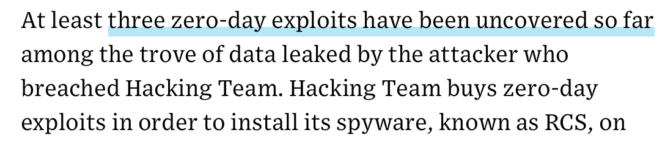
Attack + vulnerability
Attack + Vulnerability → Intrusion
0-day vulnerability
A vulnerability not publicly known, only privately
Exploit
Piece of code that activates a vulnerability
Alternative meaning: to exploit = to run an attack
Hacking Team hack (!) 2015: http://www.wired.com/2015/07/hacking-team-leak-shows-secretive-zero-day-exploit-sales-work/

Slide 35
Types of software vulnerabilities
a classification:
Design vulnerability
inserted during the software design
Coding vulnerability
introduced during coding (often a bug with security implications)
Operational vulnerability
caused by the environment in which the software is executed or its configuration

Slide 36
Vulnerabilities (cont)
Important sources about vulnerabilities:
Recent vulnerabilities (non-exhaustive): CERTs
http://www.cert.pt/ http://www.us-cert.gov/
Classification of vulnerabilities: Common Weakness Enumeration
http://cwe.mitre.org/ http://cwe.mitre.org/data/
Catalog of vulnerabilities: Common Vulnerabilities and Exposures http://cve.mitre.org/ - Example: CVE-2014-0160 (Heartbleed)
CVE’s ids enable data exchange between security products
National Vulnerability Database: CWE + CVE +…
Recent vulnerabilities (not organized): Bugtraq
http://www.securityfocus.com/archive/1

Slide 37
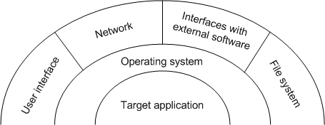
Attack surface
Attacks enter through interfaces – attack surface
what’s the attack surface is the 1st question when speaking of an application security
not trivial to understand in large software so there’s much work on measuring it

Slide 38
Attacks
Attack vector – several senses…
Type of vulnerability (BO, SQL injection,…)
Mode of attack (virus, worm,…)
Attacks often involve malware
Virus, worms, bots, rootkits, trojans,…
Can be technical vs. social engineering
Can be directed or not
Advanced Persistent Threats (APTs)
Can be manual vs. automated
Separation is not so clear (manual is never entirely so)
Classification of attacks: Common Attack Pattern Enumeration and Classification (CAPEC) - https://capec.mitre.org

Slide 39
Manual attack
Most steps are optional:

Slide 40
Manual attack
Footprinting
Initial information gathering about potential targets (e.g. IP addresses, protocols, systems connected to the internet) with DNS, databases, WHOIS
Scanning
Looking for reachable systems, open ports (port scanning w/nmap)
Fingerprinting – discovering software versions used
Enumeration
More intrusive; info about network resources/shares, users/groups, software
Discover vulnerability(ies)
Manually or with scanning tools (Nessus, OpenVAS, Havij for SQLI)
Attack itself, running the exploit → intrusion
Privilege escalation (by exploiting another vulnerability(ies))
Installing rootkit / backdoor / ...
Covering tracks

Slide 41
Automated attack 1: Worm

Slide 42
Automated attack 1: Worm
Components of a worm:
Target selector
Scanning motor
Warhead – exploit code
Load – what is carried by the worm (e.g. bot/rootkit code)
Propagation motor – moves the worm
Equivalent to footprinting,
scanning, enumeration

Slide 43
Automated attack 2: Drive-by download
Most common automatic attack today
Web pages with malware
When user accesses one with a vulnerable browser, the malware exploits the vulnerability
Vulnerability can be in the browser, ActiveX engine, JVM, Flash Player, PDF reader,…
“We analyzed the content of several billion URLs and executed an in-depth analysis of approximately 4.5 million URLs. From that set, we found about 450,000 URLs that were successfully launching drive-by-downloads of malware binaries and another 700,000 URLs that seemed malicious but had lower confidence.” (paper at HotBots’07 wit authors from Google)
Example: http://www.seguranca-informatica.net/2013/09/fbi-recorre-malware.html

Slide 44
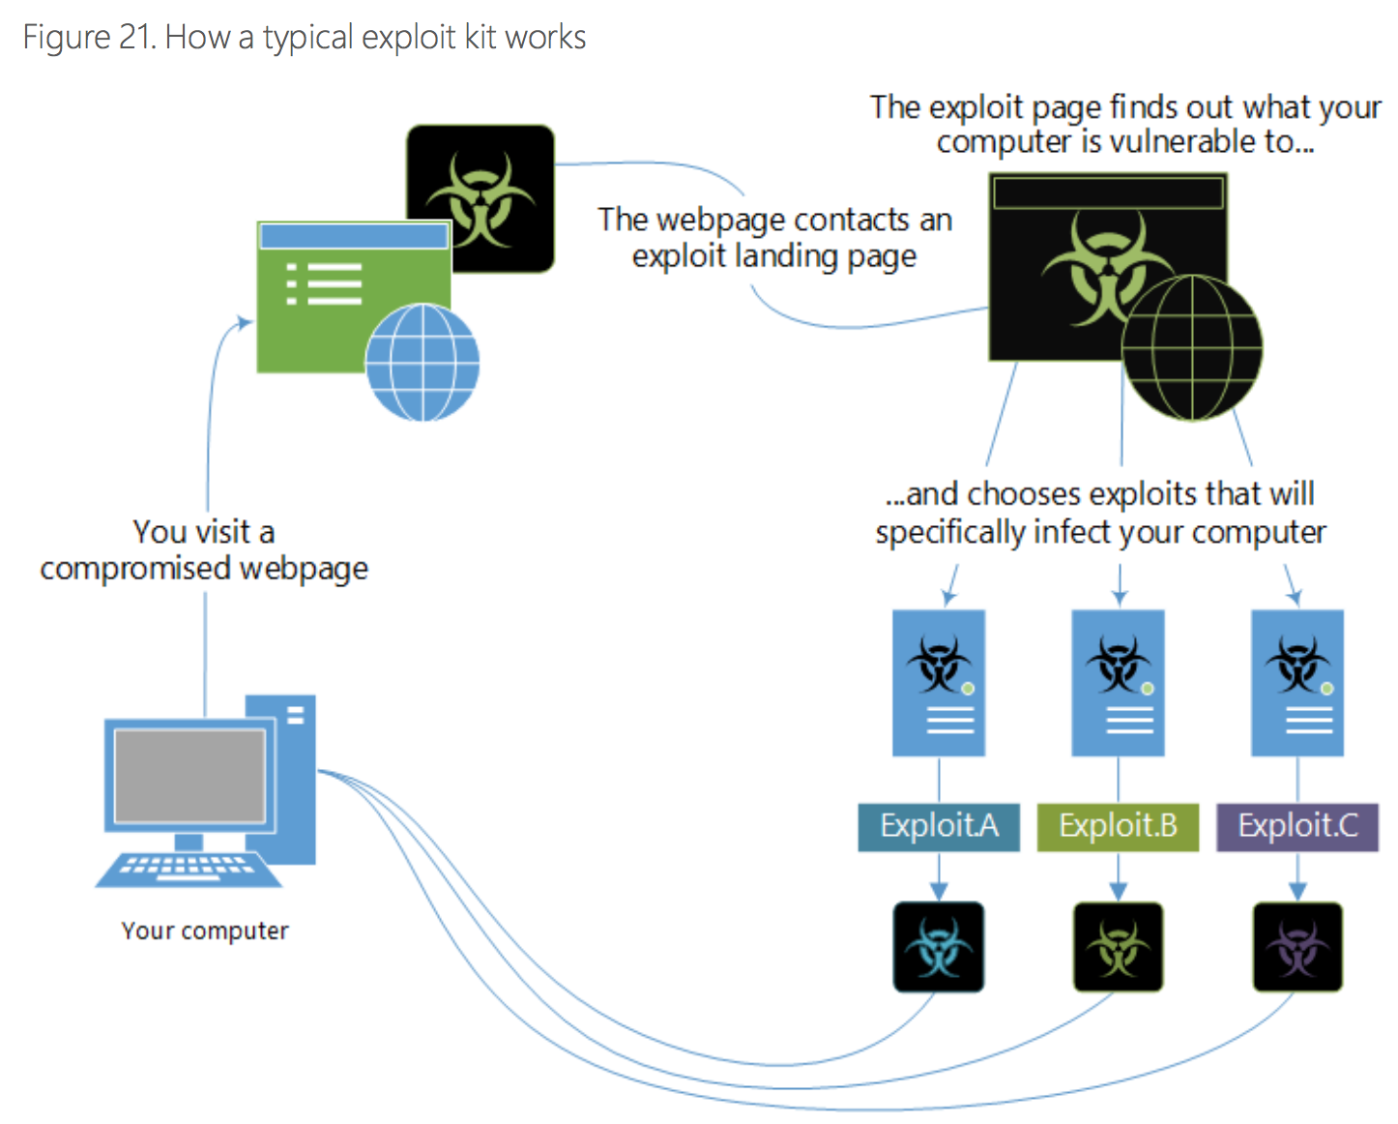
Drive-by download
source: Microsoft Security Intelligence Report vol 17, 2014

Slide 45
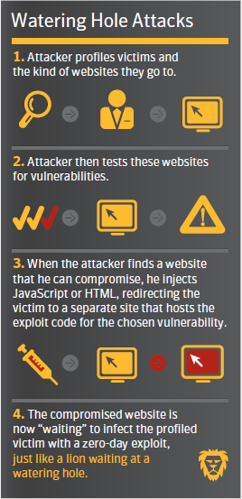
Watering Hole
automated, targeted attack, involving a drive-by download
Picture from Symantec Internet Security Threat Report 2013

Slide 46
Virus and Trojans – automated
Virus - similar to worms but propagate with physical contact – usb drives, disks, mp3 player, cameras,…
Thumb drive attack – leave a thumb drive at the floor; when someone collects it and inserts in a computer, a virus infects it; used against US DoD in 2009, possibly Stuxnet
BYOD (Bring Your Own Device) – personal devices such as smartphones, tablets, etc. may bring malware
Trojan horse – similar but requires user to run an infected program

Slide 47
Backdoors, Rootkits, Bots, RATs
Backdoor – allows attacker to come back later; APTs often use several backup backdoors; related concepts:
Rootkit – a malicious program that hides at low level
Classical: fake login program that allows users not in /dev/passwd to enter; false ps to hide malicious programs
Bot or Remote Access Trojan (RAT) – listen at a port until they are contacted by a command&control server (C&C) to do something; ex:
Access and extrude information
Invade other machines in the organization
Send SPAM, send rogueware announces, do DDoS attacks

Slide 48
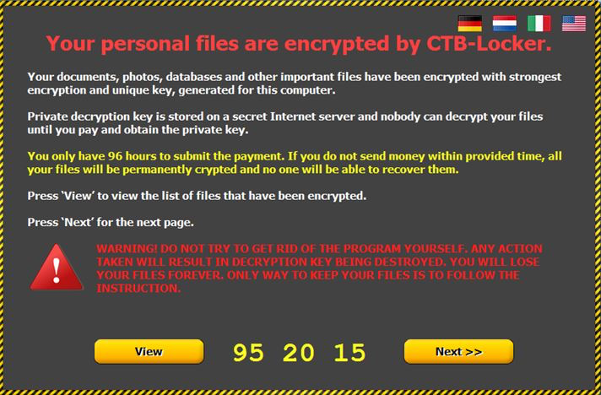
Ransomware, Scareware, Rogueware
Ransomware – malware that encrypts disks or databases and asks for a ransom (payment is weak link in online fraud so often done in bitcoins)
Scareware – scam to convince victims to buy/install useless or malicious software (e.g., fake antivirus software)
Rogueware – malicious software used in these scams
http://exameinformatica.sapo.pt/noticias/internet/2015-02-06-Ja-ha-empresas-portuguesas-a-pagar-pelo-resgate-de-bases-de-dados

Slide 49
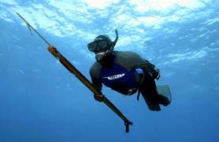
Phishing and spear phishing
Phishing – send an email, Facebook post,… that leads user to do a dangerous operation (usually to introduce credentials)
Involves social engineering, victim has to “cooperate”
http://www.seguranca-informatica.net/2013/03/phishing-e-mulas.html
Spear phishing – a directed phishing attack
Attacker sends email with exploit to person with adequate access level at company

Slide 50
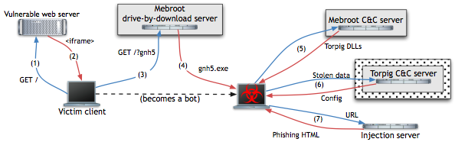
Torpig – a sophisticated malware
Infection of bots with drive-by download:
Attackers modify legitimate but vulnerable server for some webpages to request JavaScript code from the attacker’s web server
(1) The victim’s browser accesses the vulnerable server
(2) JavaScript code exploits the browser/plugins/etc.
(3-4) If an exploit is successful, the script downloads and installs the Mebroot rootkit (replaces Master Boot Record) – victim becomes a bot

Slide 51
Torpig (cont.)
Mebroot has no attack capacity:
(5) Contacts C&C server to obtain malicious modules
Stores them encrypted in system32 and changes the names and timestamps to avoid suspicions
Every 2h contacts C&C server: sends its configuration (type/version of modules); gets updates; communication is encrypted over HTTP

Slide 52
Torpig (cont.)
(5) For Torpig, the Mebroot modules are Torpig’s
They are injected in legitimate software: service control manager (services.exe), file manager, web browsers, email clients, etc.
Torpig inspects those programs and steals data
e.g., credentials for online accounts, passwords
(6) Every 20 minutes contacts C&C to upload stolen data
C&C replies ok or tells bot to do… (next slide)

Slide 53
Torpig (cont.)
Man-in-the-browser phishing attack
(7) When victim visits domain from a list (e.g., a bank), the bot contacts an injection server
Injection server returns attack data: URL of trigger page in the legitimate domain (typ. the login page), where to send results, etc.
When user visits trigger page, Torpig asks injection server for another page (e.g., that asks for credit card number)

Slide 54
Intelligence-driven security
Data like the previous is important to know what to protect
Current trend in security: intelligence-driven
Security based on recent intel about threats
Security vendors get “intel” from some clients and pass it to others

Slide 55
Security and Dependability
Security: the objective is to avoid that ill intentioned people make the system fail
Dependability (or Fault Tolerance): the objective is to avoid that the system fails
classically tends not to consider malicious faults
classically tends not to consider information confidentiality
currently it is handling these problems under the name of Intrusion Tolerance

Slide 56
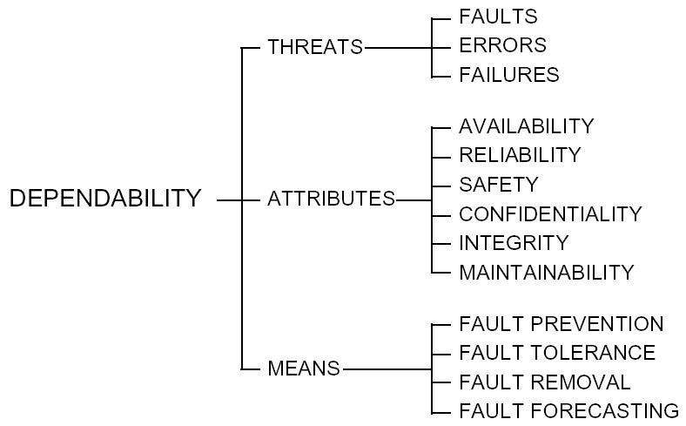
Objectives
security
Dependability Tree. Avizienis et al. 2004

Slide 57
Dependability means
Fault prevention
Means to avoid the introduction of faults; part of the software (or hw) development process (e.g., testing)
Fault tolerance
Means to avoid the system failure when there are faults
Fault masking – means involving redundancy to avoid that faults cause failures
Detection and processing – means involving detecting errrors and processing them in order to neutralize them
Fault removal
Means used during the design to reduce the number and severity of faults (verification, validation)
Fault forecasting
Means to estimate the number of faults in the system and when they will happen in the future

Slide 58
Summary
Basic concepts
Vulnerabilities, attacks
Security and Dependability

Slide 59
Próxima aula
I.1 Legal Framework

